Slide 1
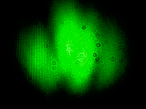
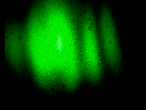
Machine learning in optical metrology
Danil Lykov, Maksim Eliseev

Slide 2
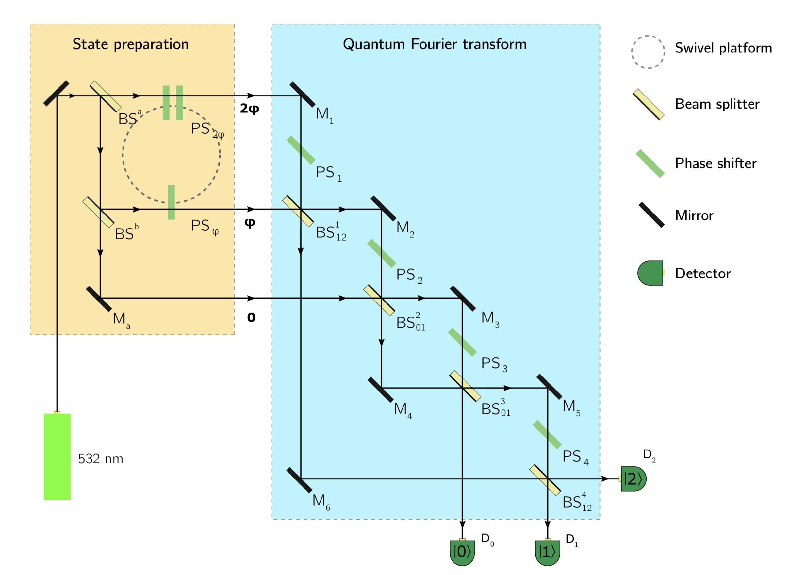


Problem
Need to predict $φ$ using images from cameras

Slide 3
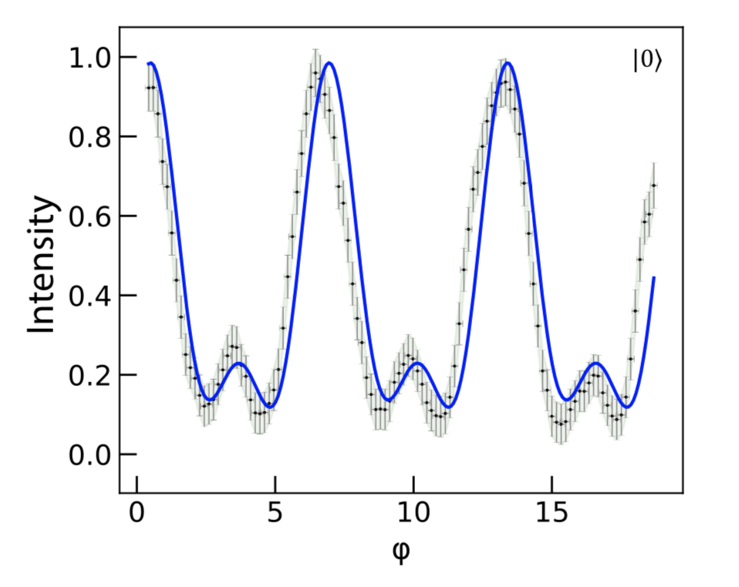
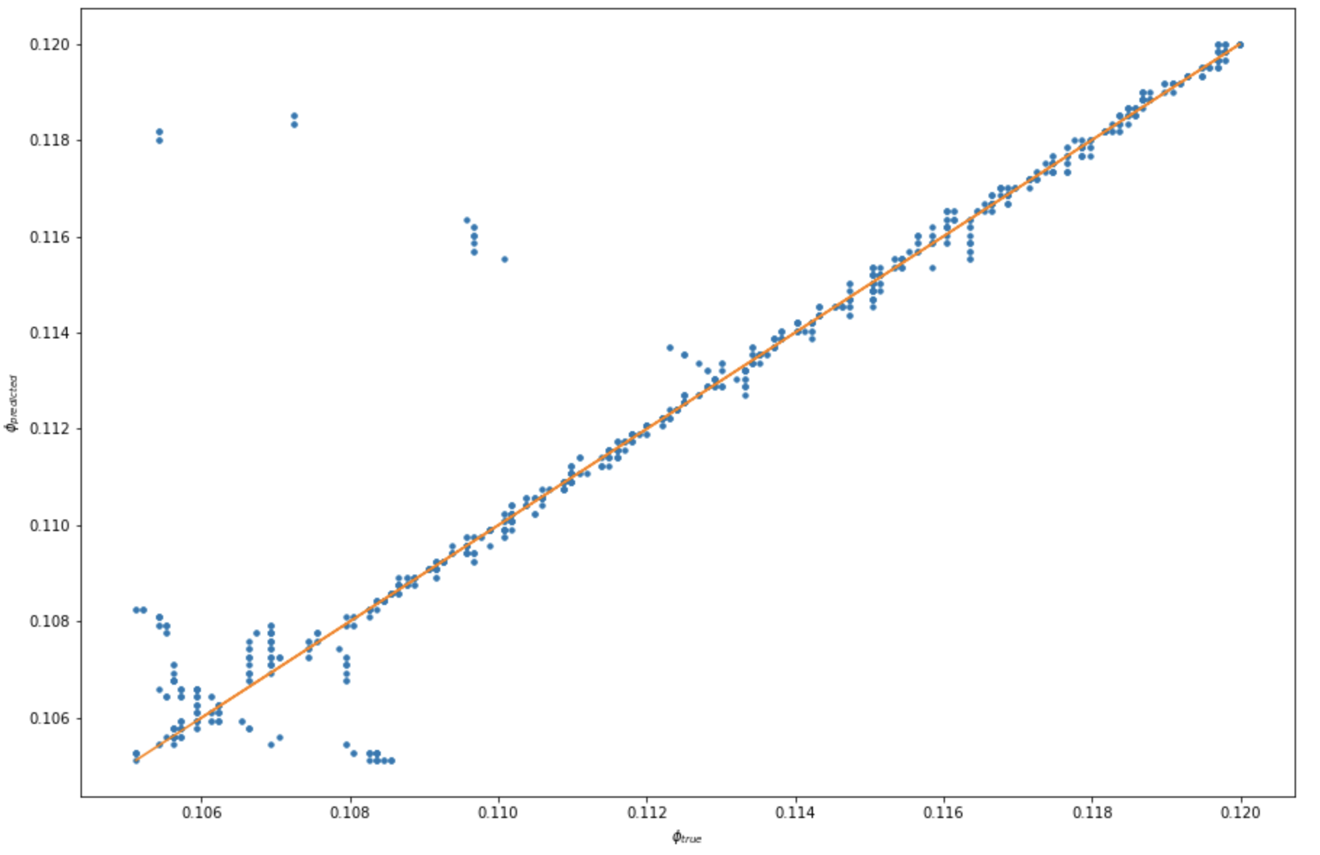
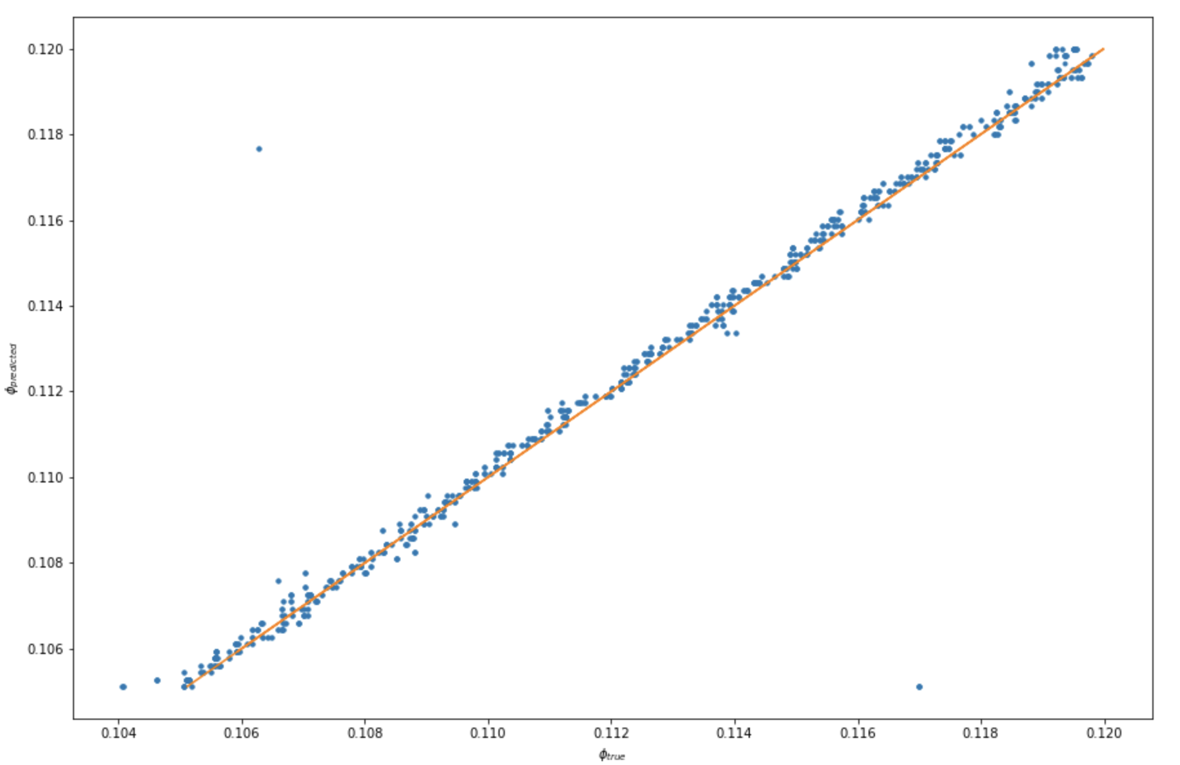
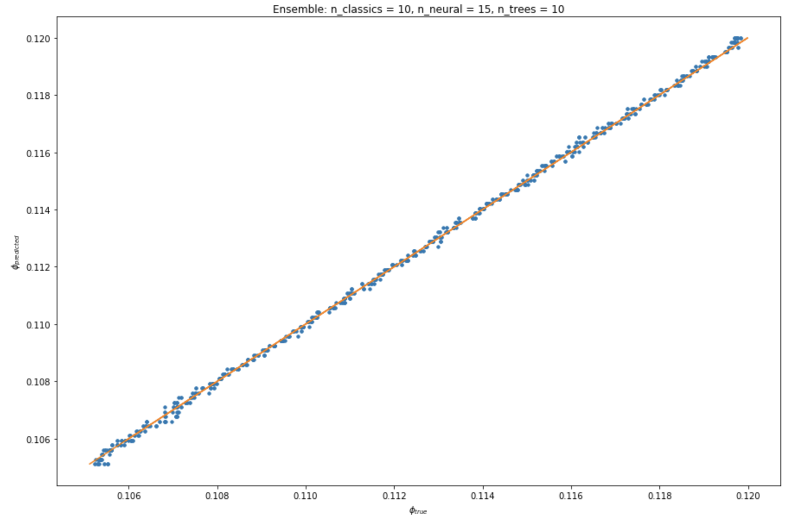
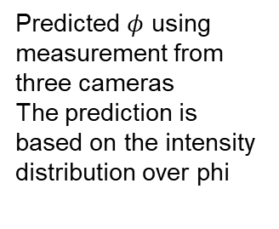
Summary
Init model
Classic model
Machine learning
Ensemble
Description
Predicted intensities using previous measurement.
Simple model, using approximation of two sinuses
Predicted $φ$ using measurement from three cameras
The prediction is based on the intensity distribution over phi
Using Machine Learning models with Principle Component Analysis
Using the images from cameras
Ensemble of 10 classical models, 15 neural nets and 10 Random Forest Regressors
Achieved the best results
MSE
2.1×10⁻⁶
1.1×10⁻⁶
5.5×10⁻⁸
6.9×10⁻⁹

Slide 4
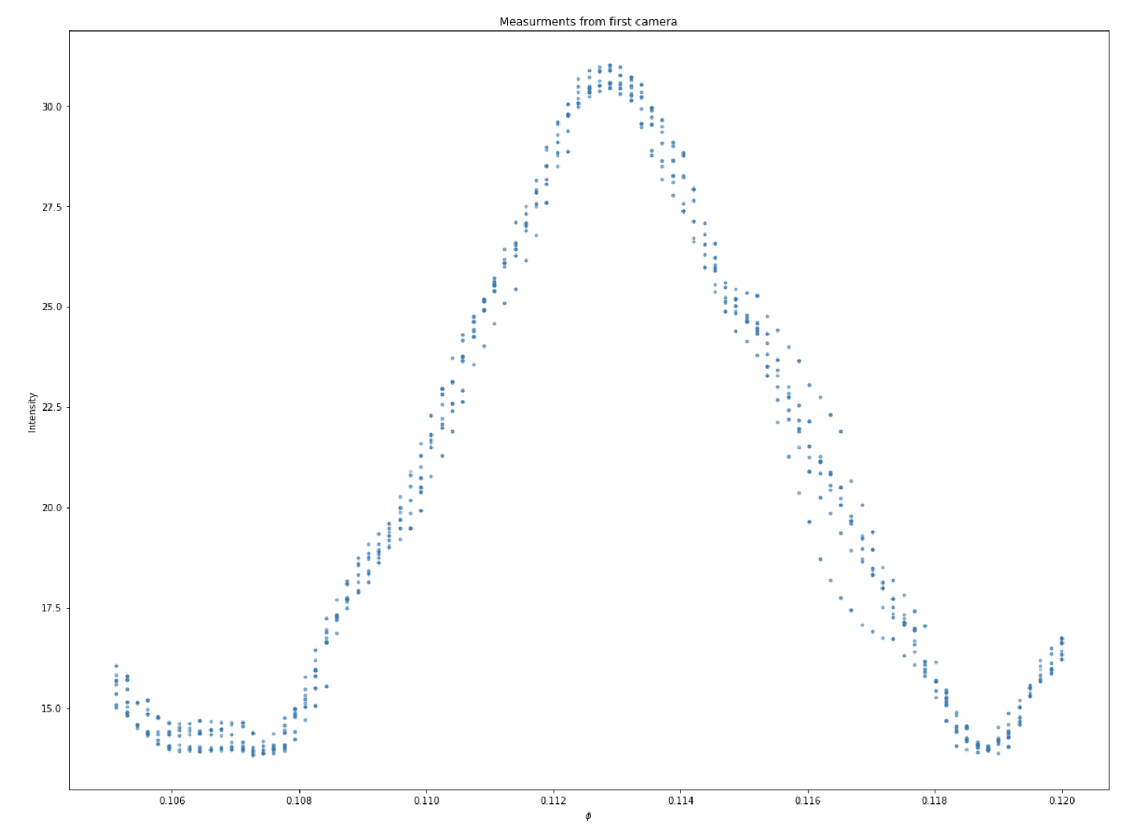
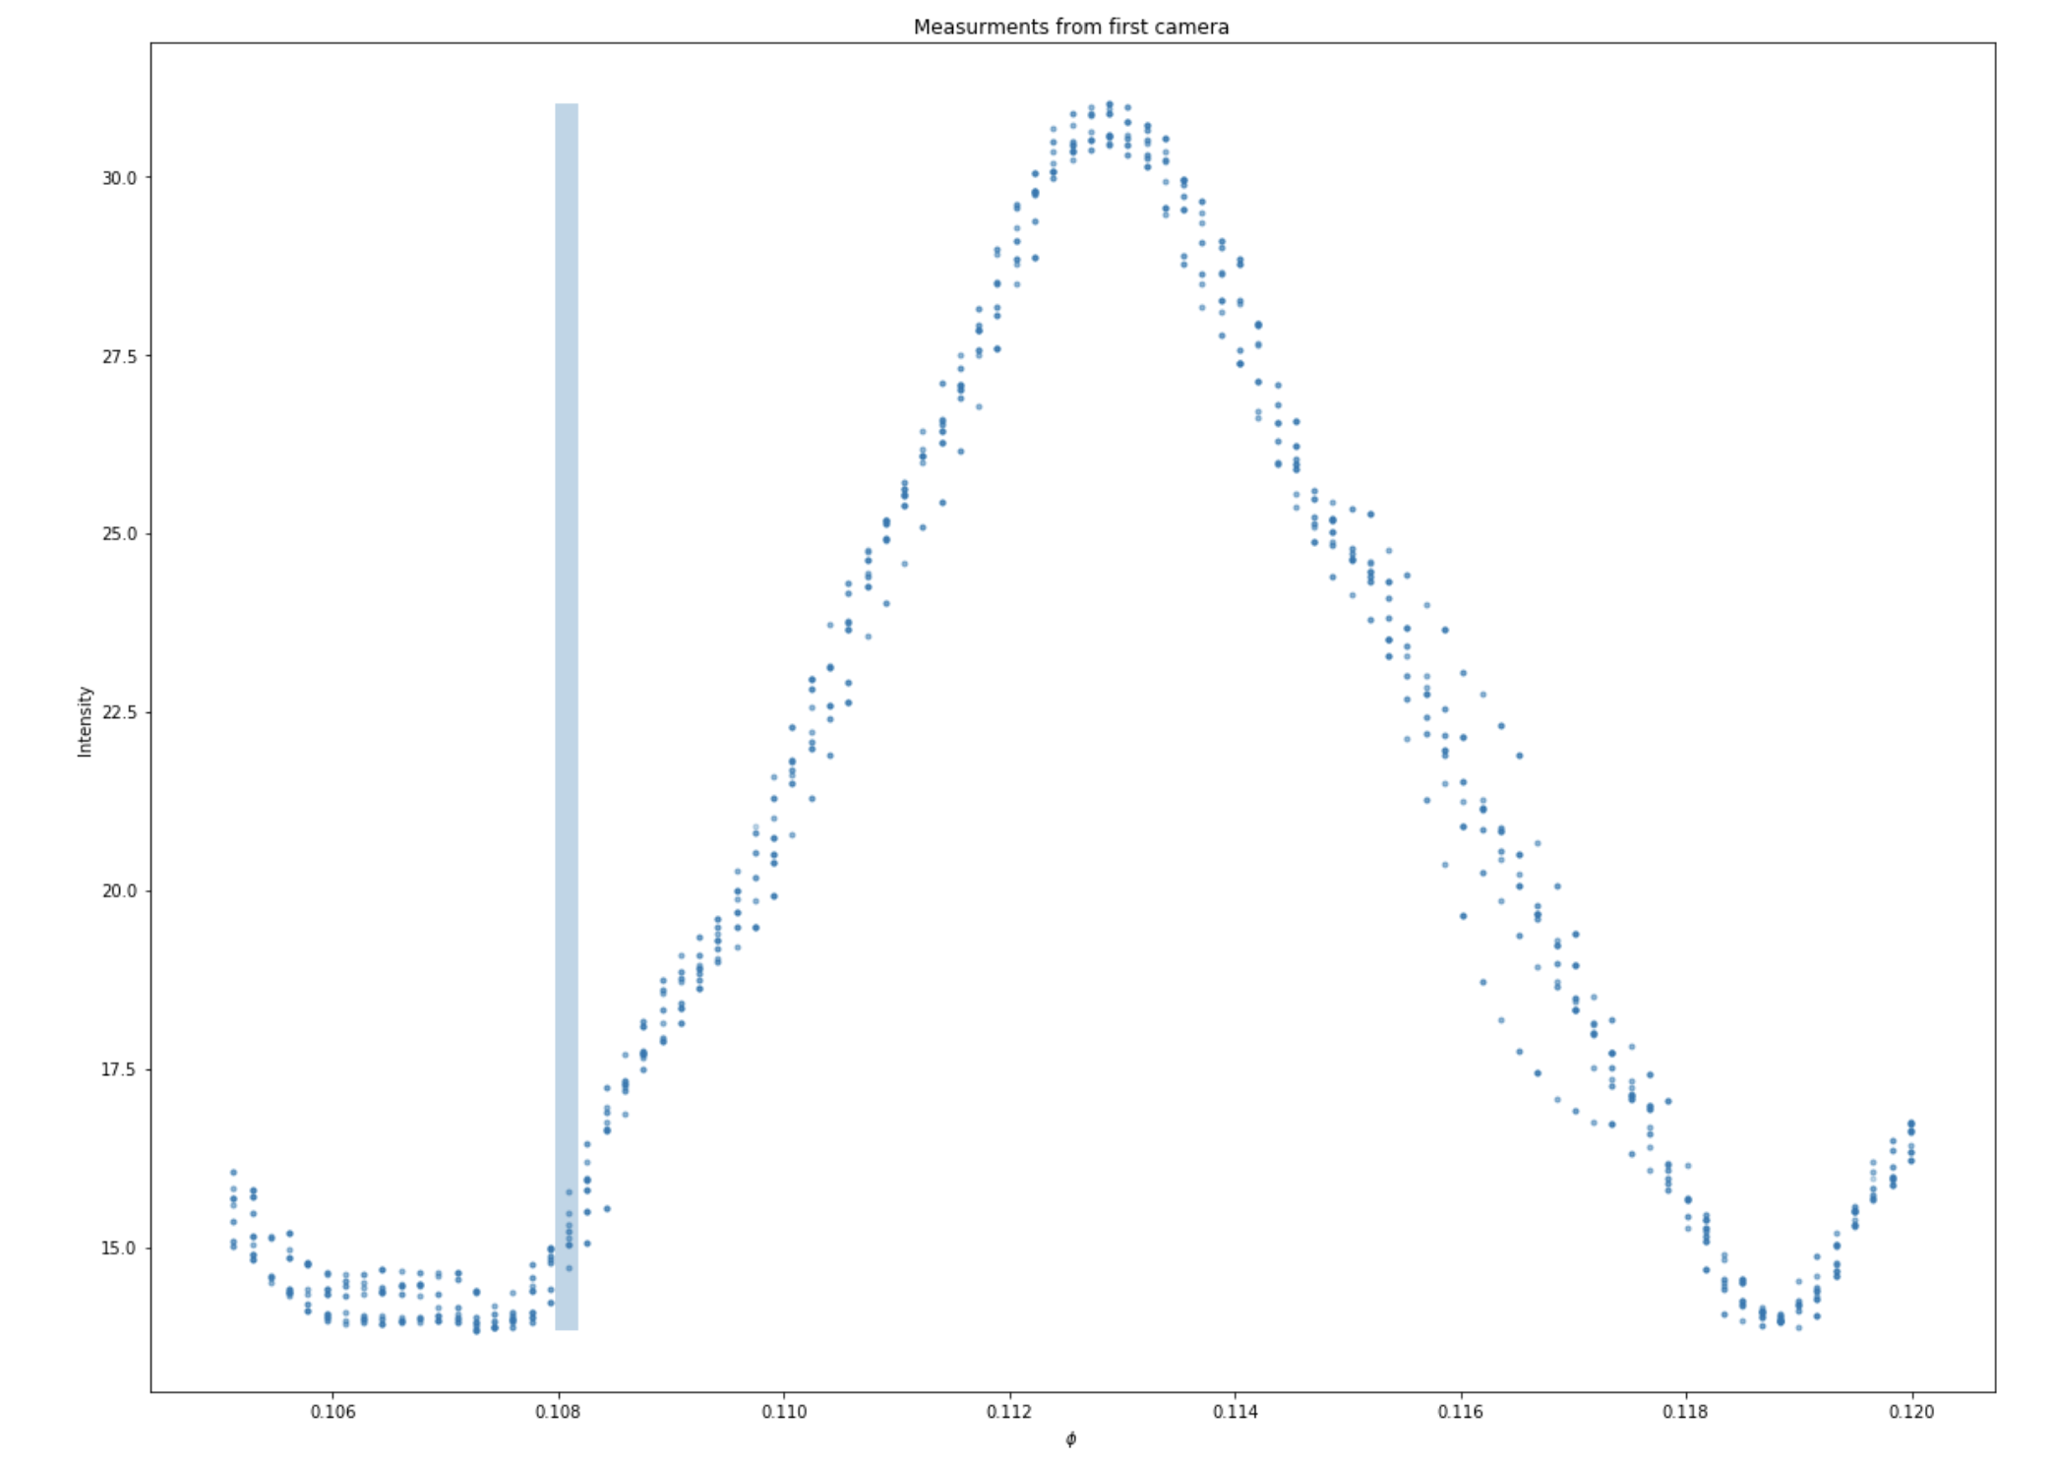
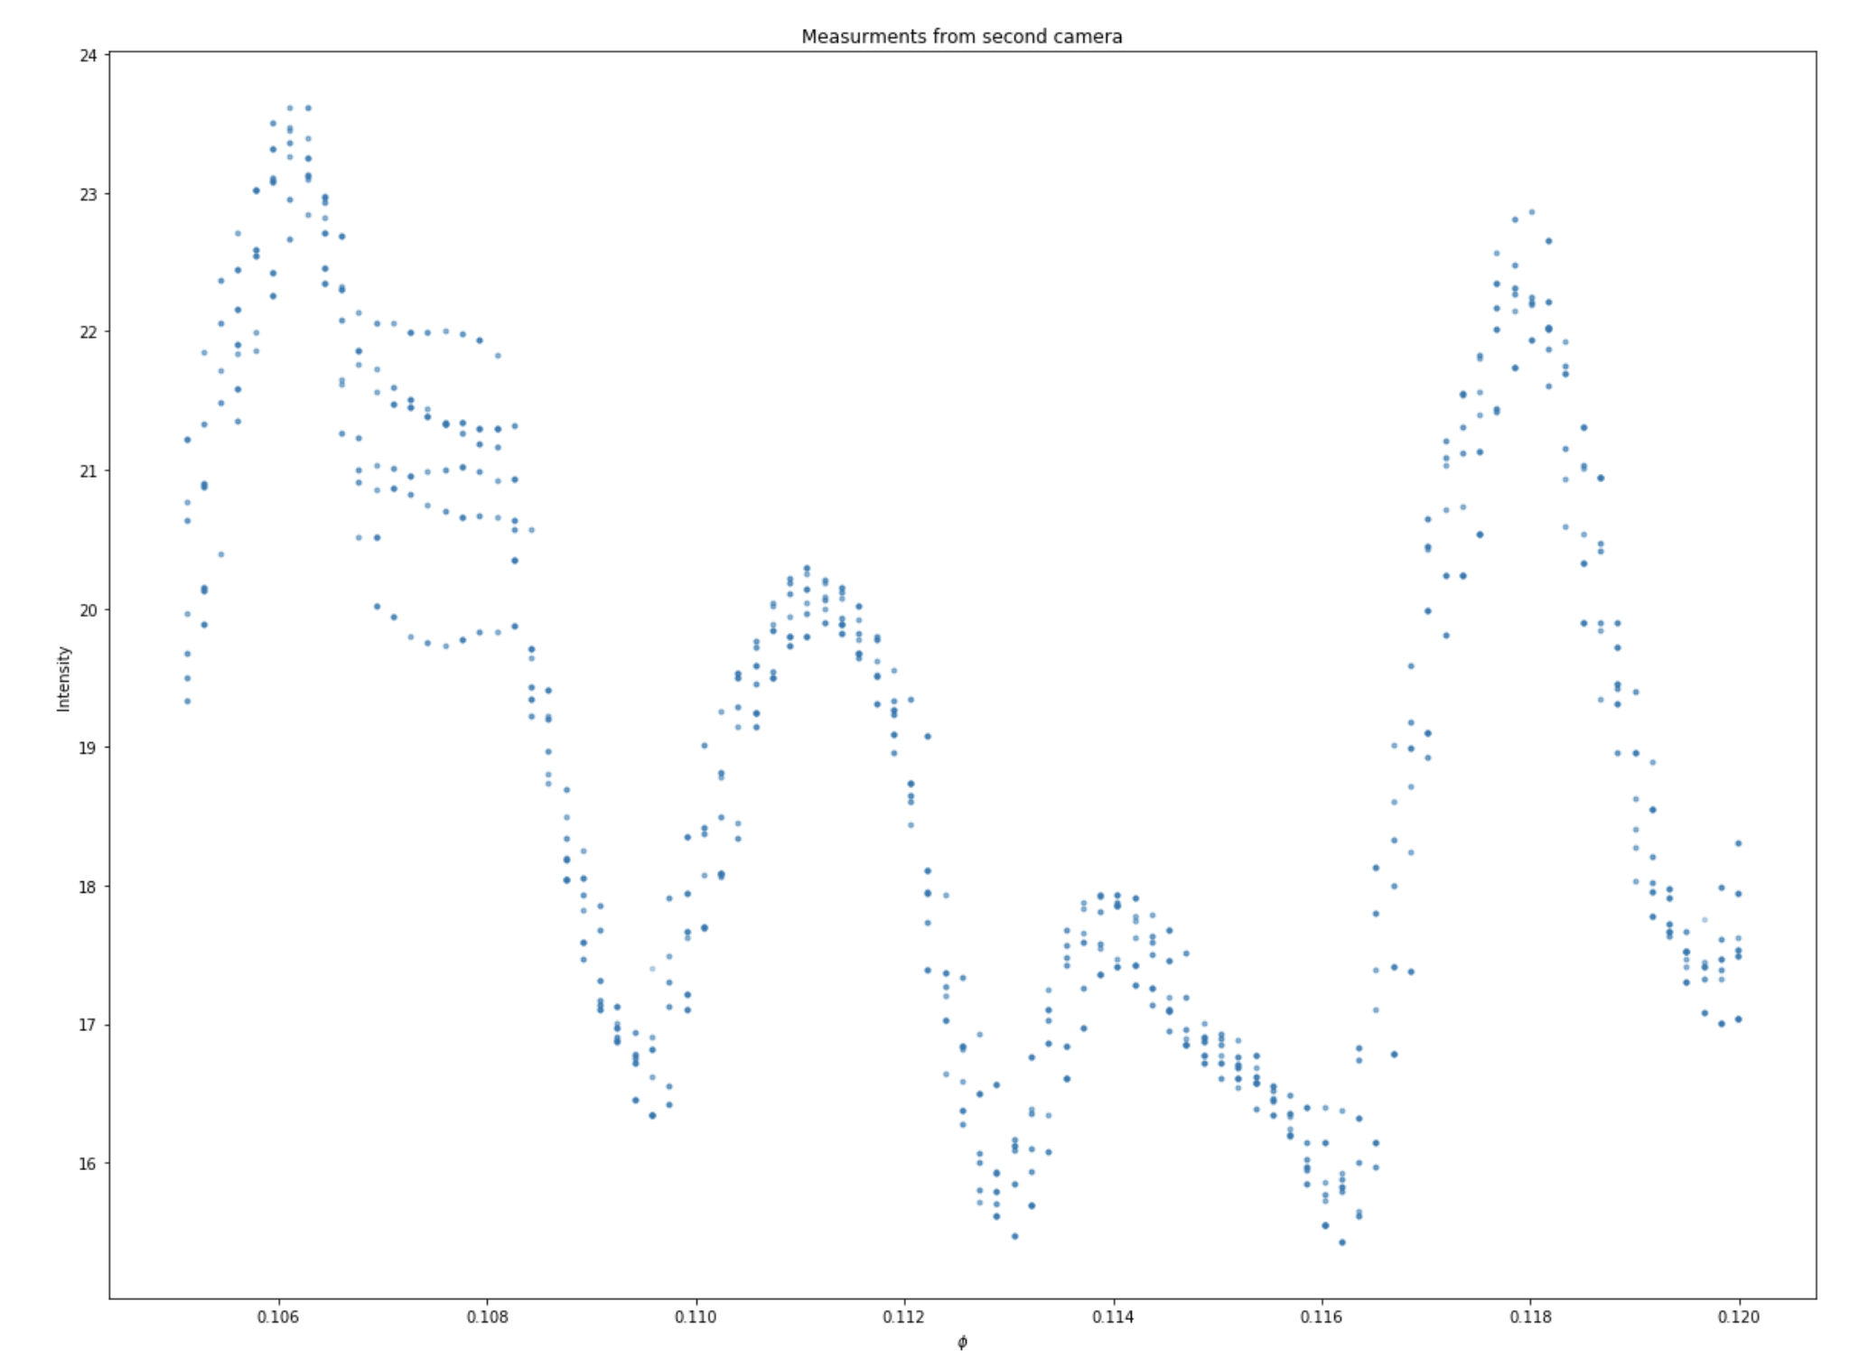
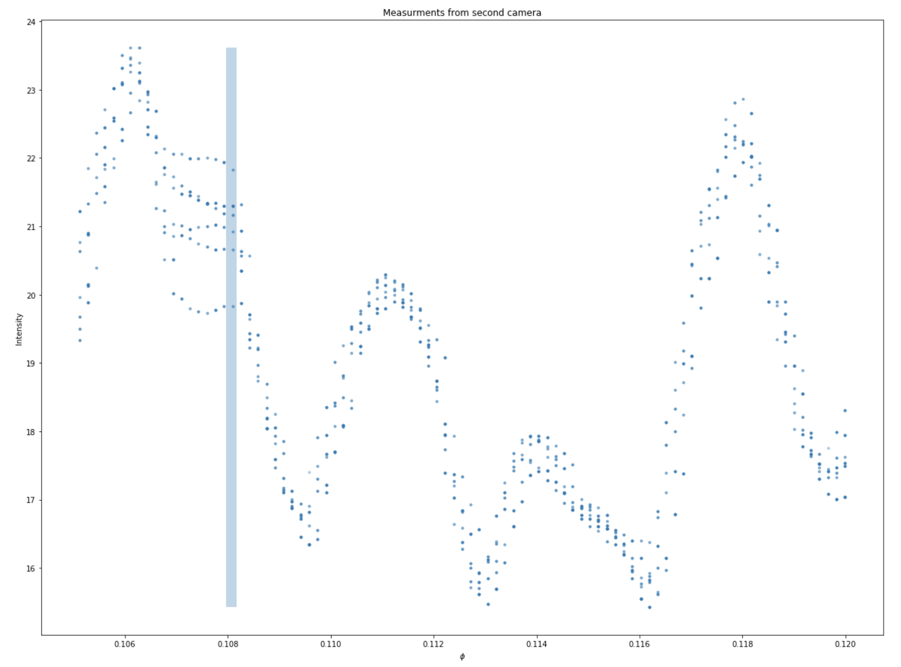
Classical Model

Slide 5
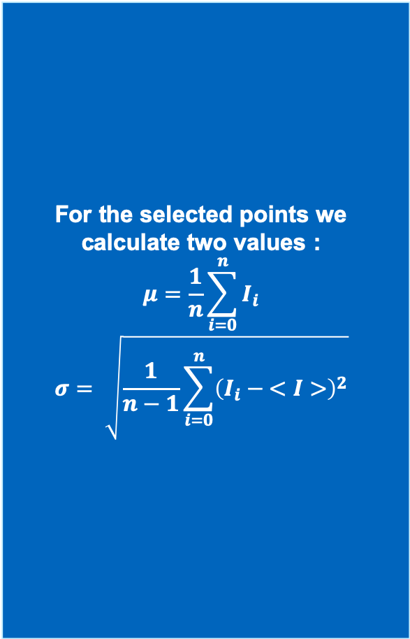
Classical Model
For the selected points we calculate two values :
$$μ=\frac{1}{n}\sum_{i=0}^{n}{I_{i}}$$
$$σ= \sqrt{\frac{1}{n−1}\sum_{i=0}^{n}{{\left(I_{i} − <I>\right)}^{2}}}$$

Slide 6
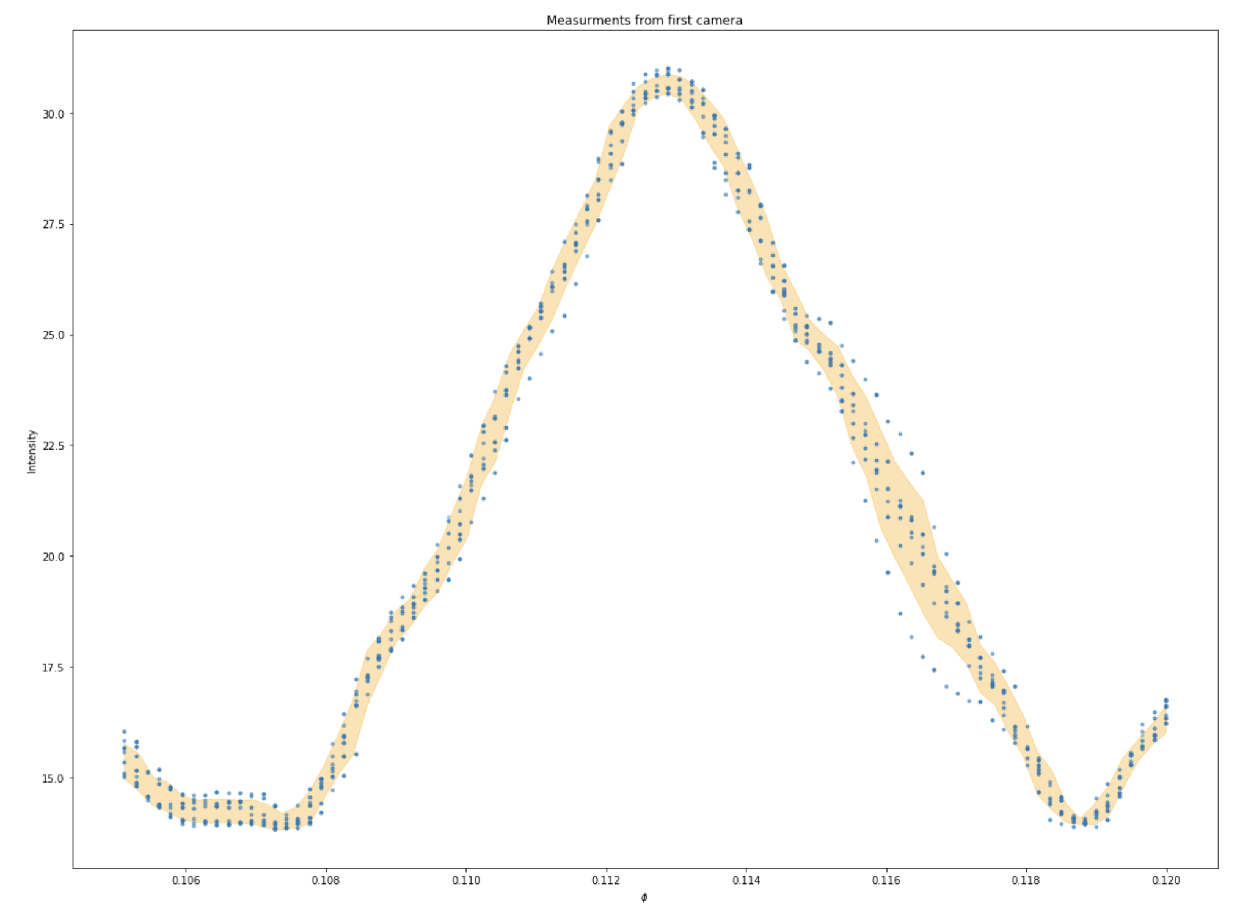
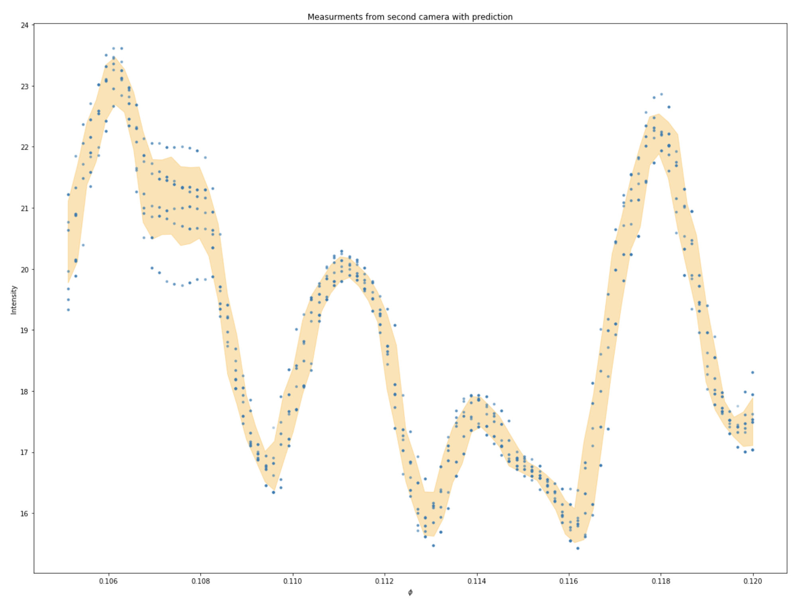
Classical Model

Slide 7
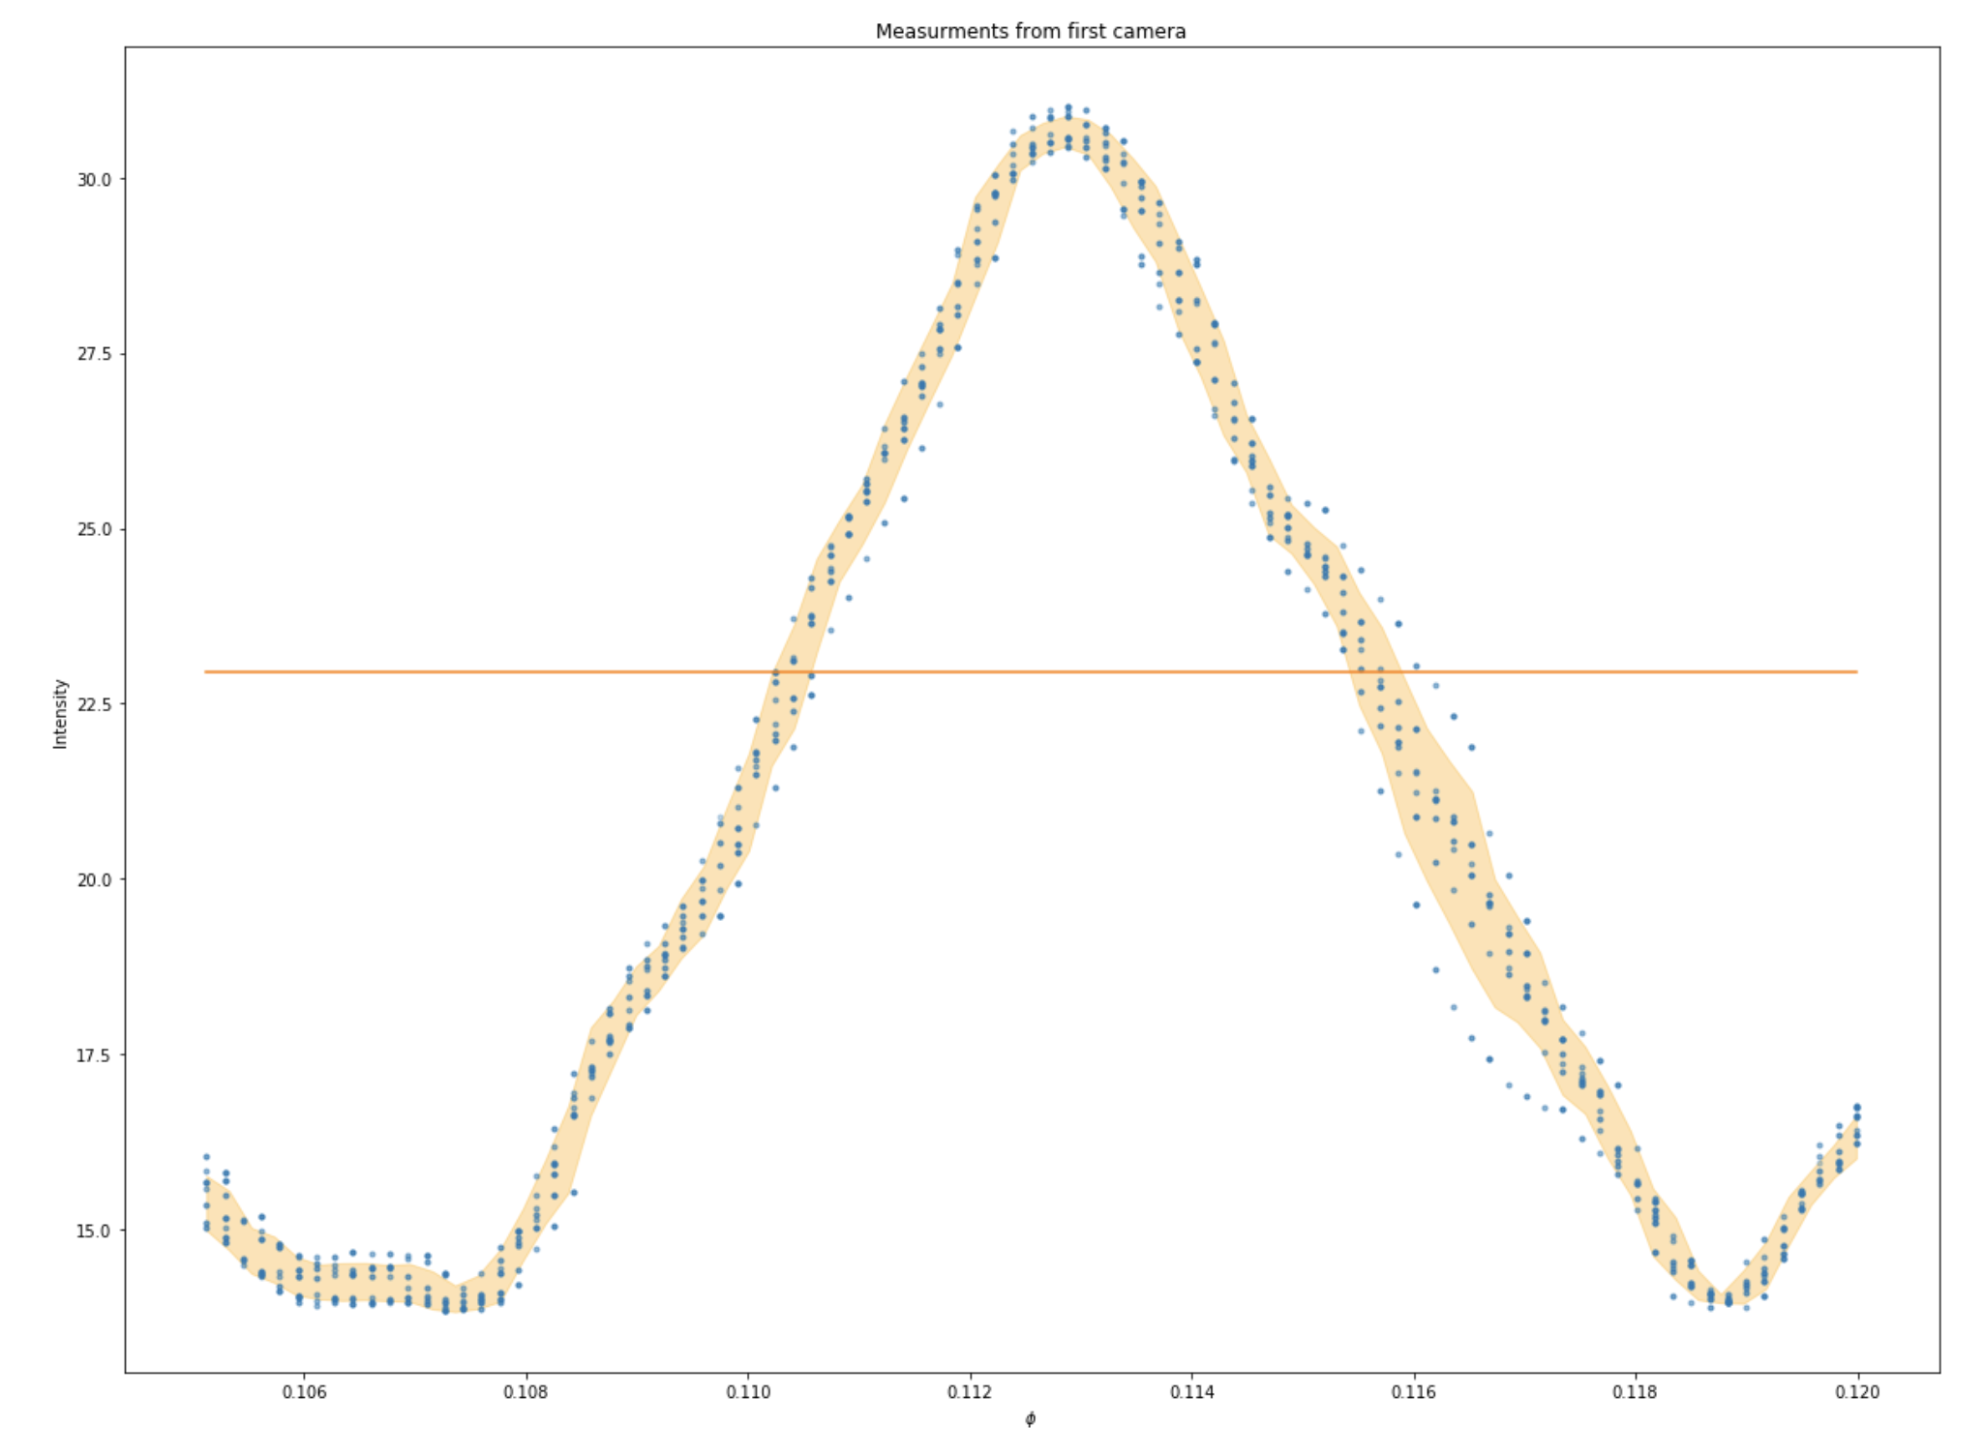
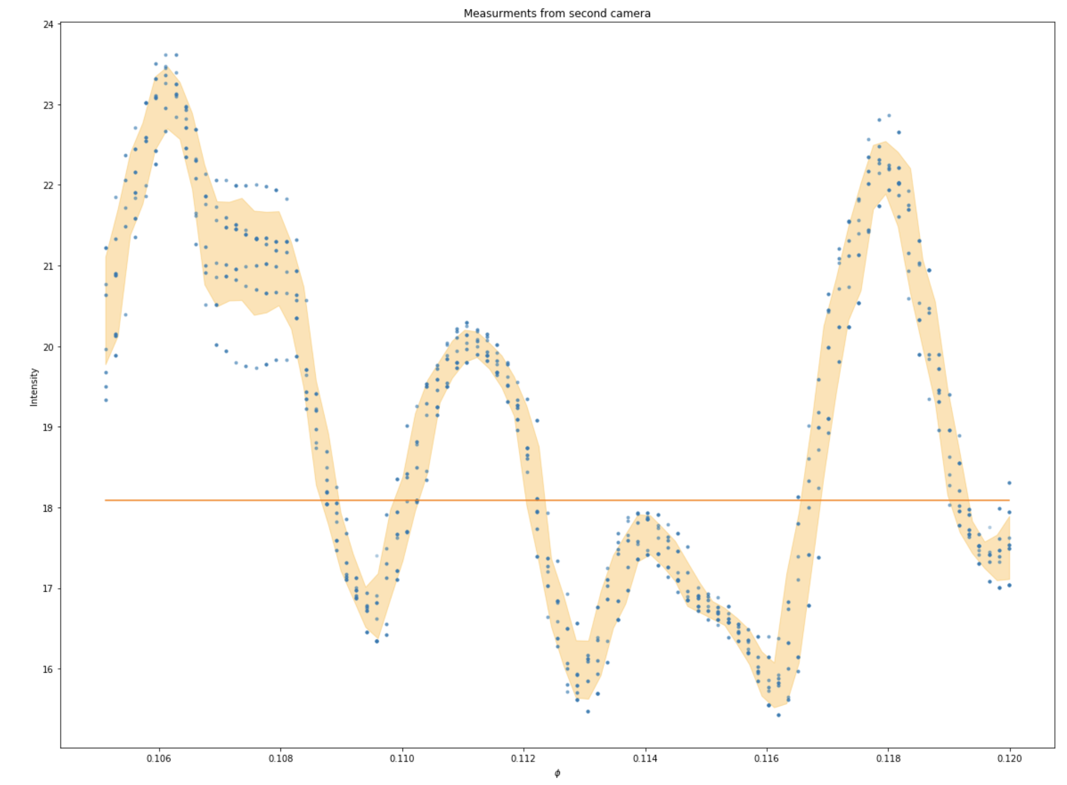
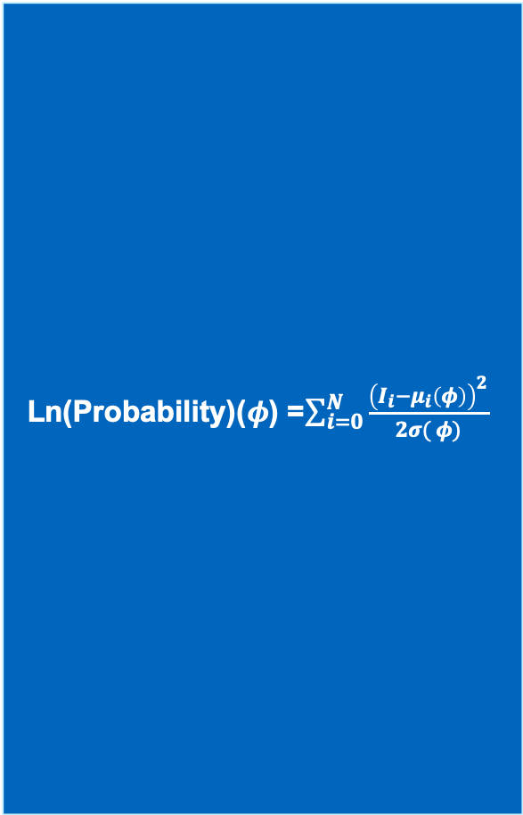
Classical Model
Ln(Probability)($φ$) =$\sum_{i=0}^{N}{\frac{{\left(I_{i}−μ_{i}\left(φ\right)\right)}^{2}}{2σ( φ)} }$

Slide 8
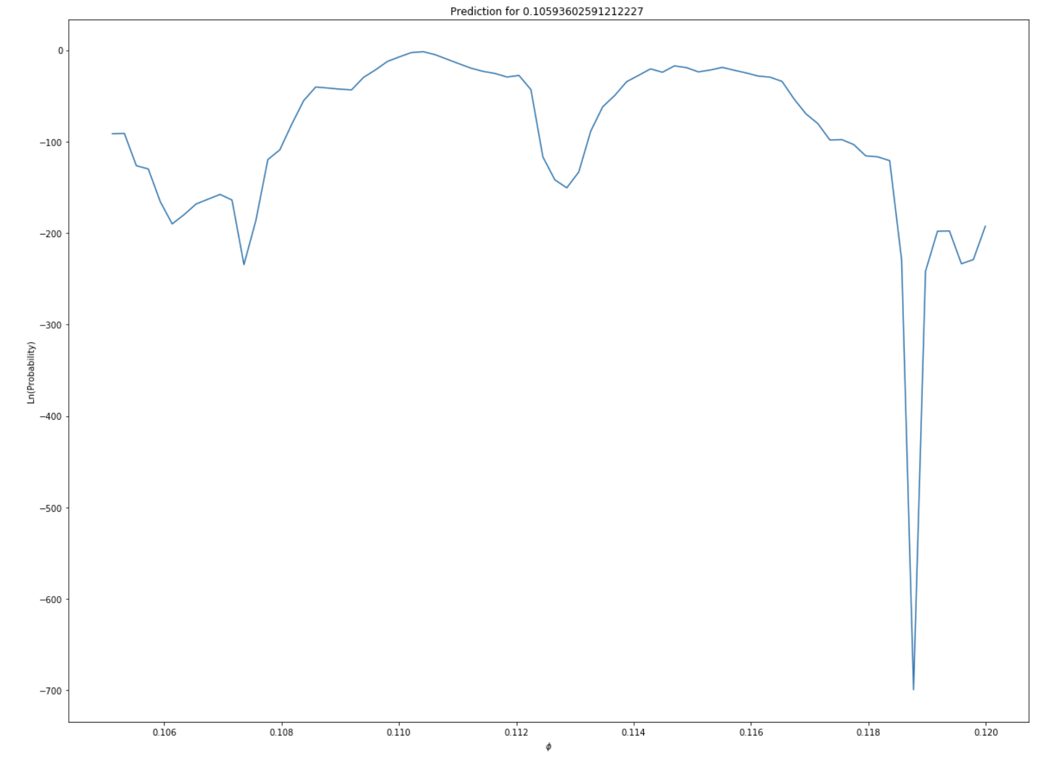
Classical Model

Slide 9
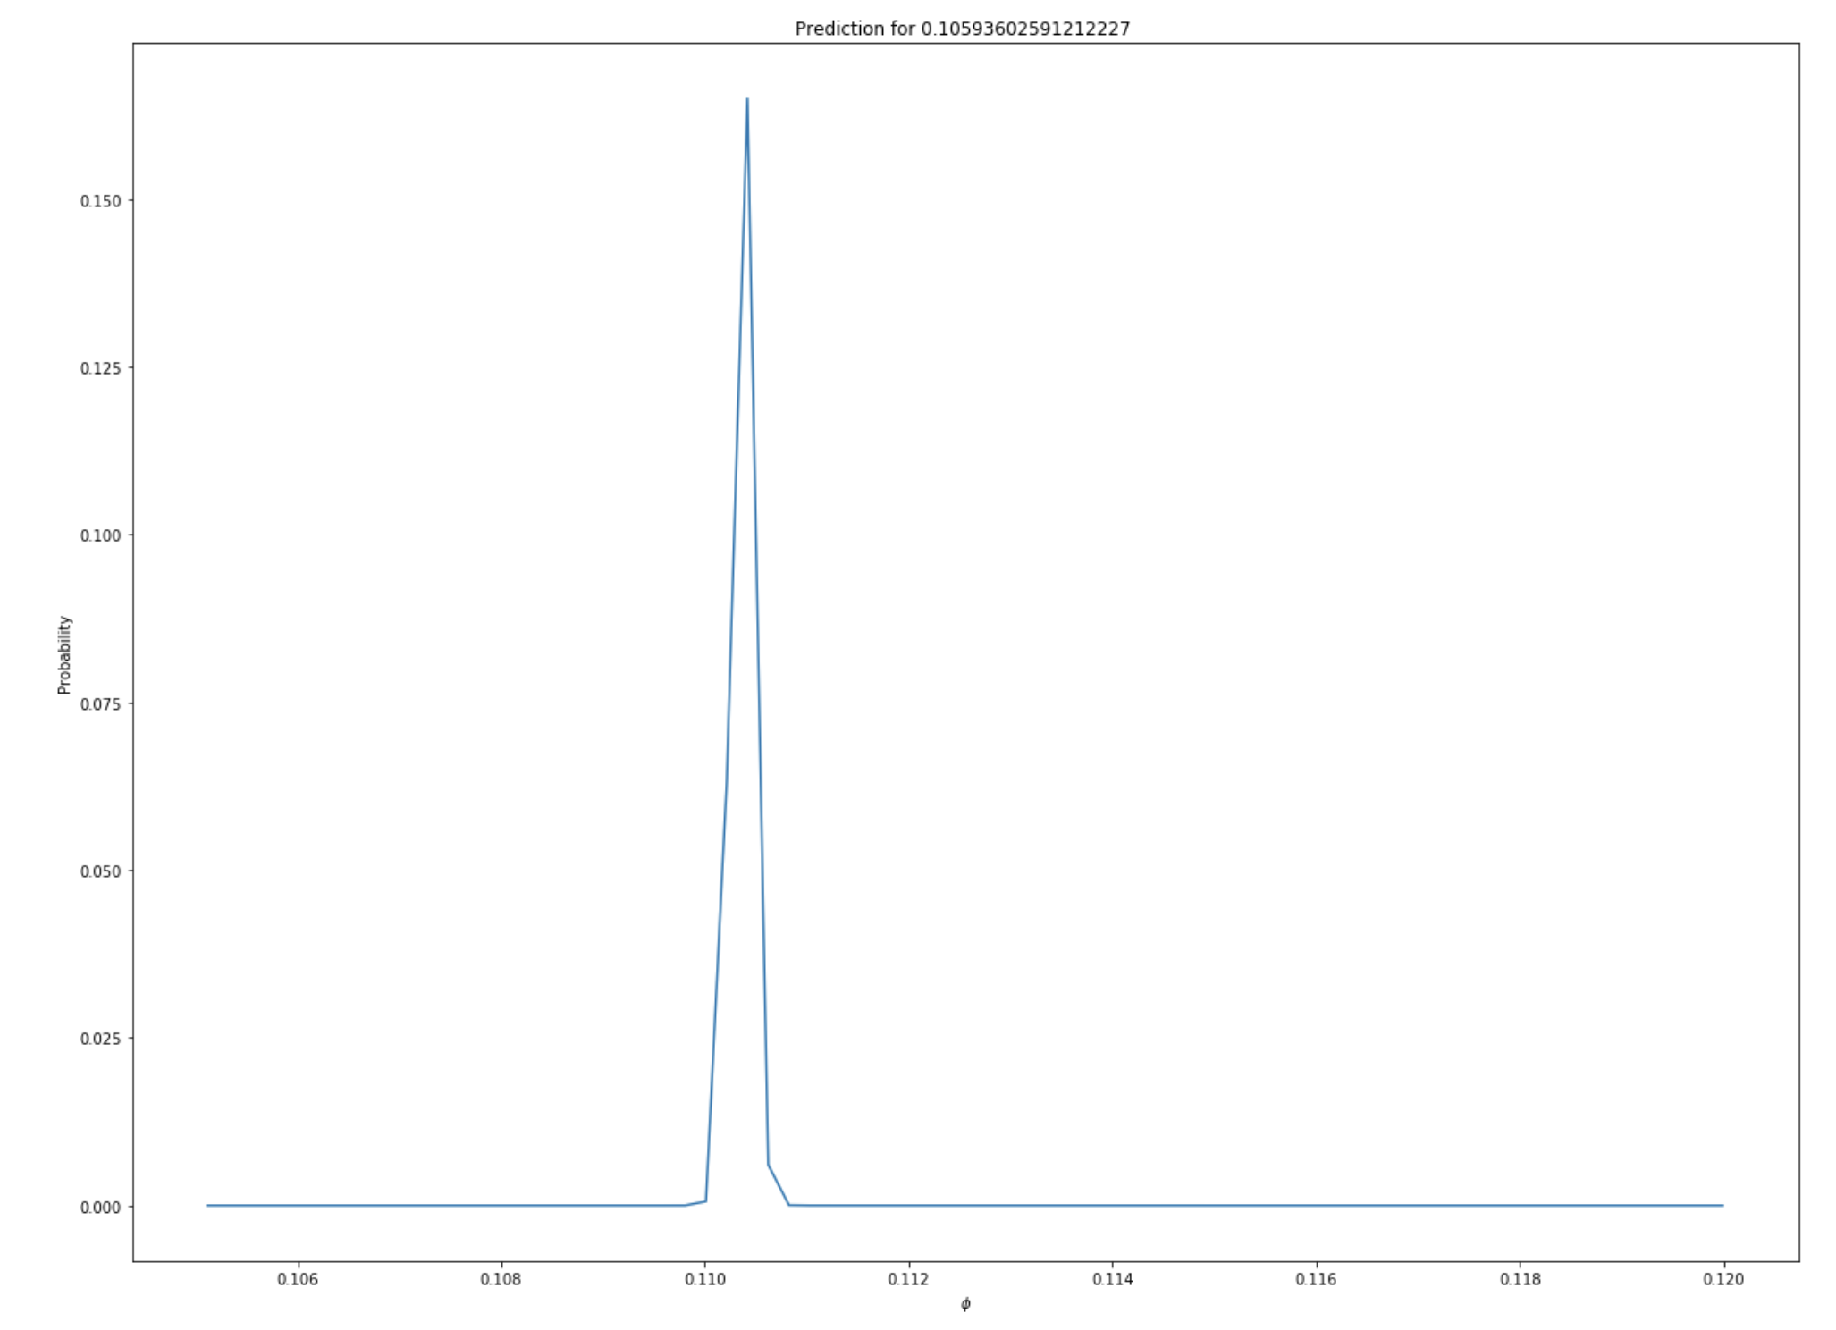
Classical Model

Slide 10
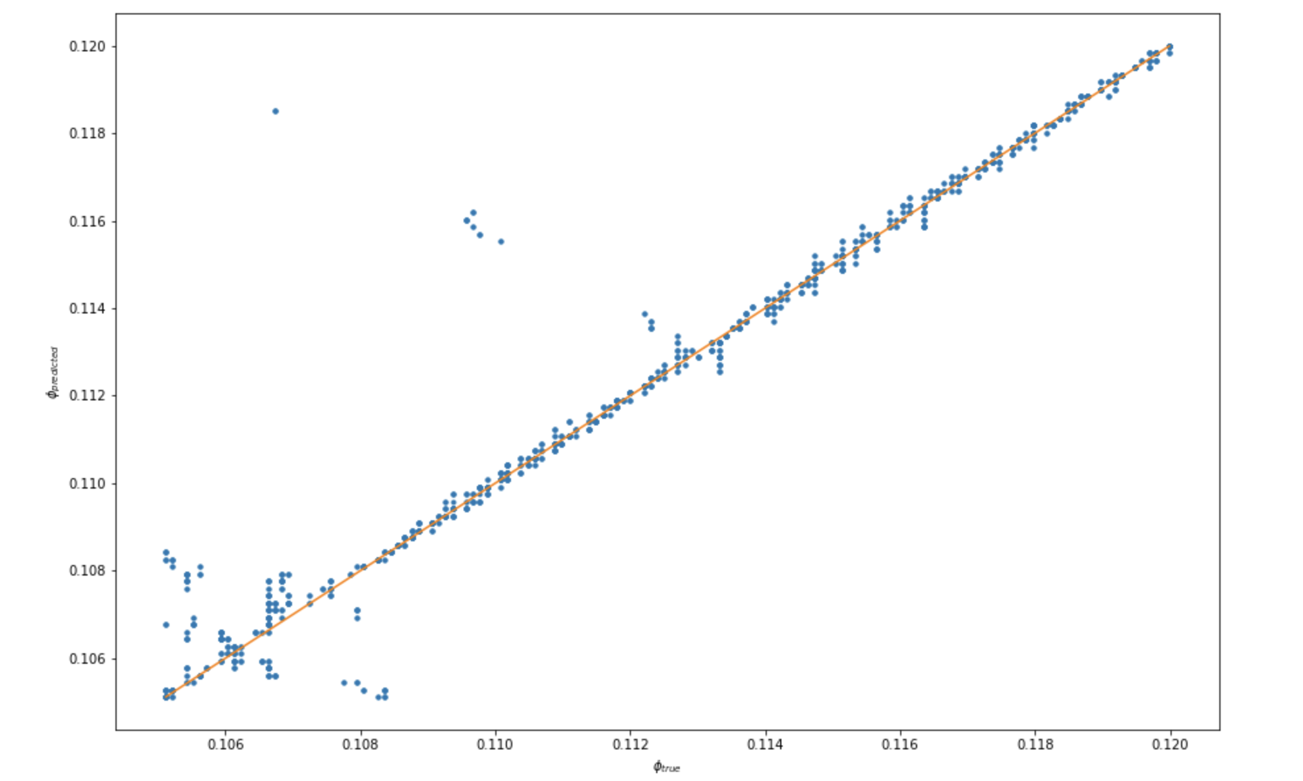
Classical model

Slide 11
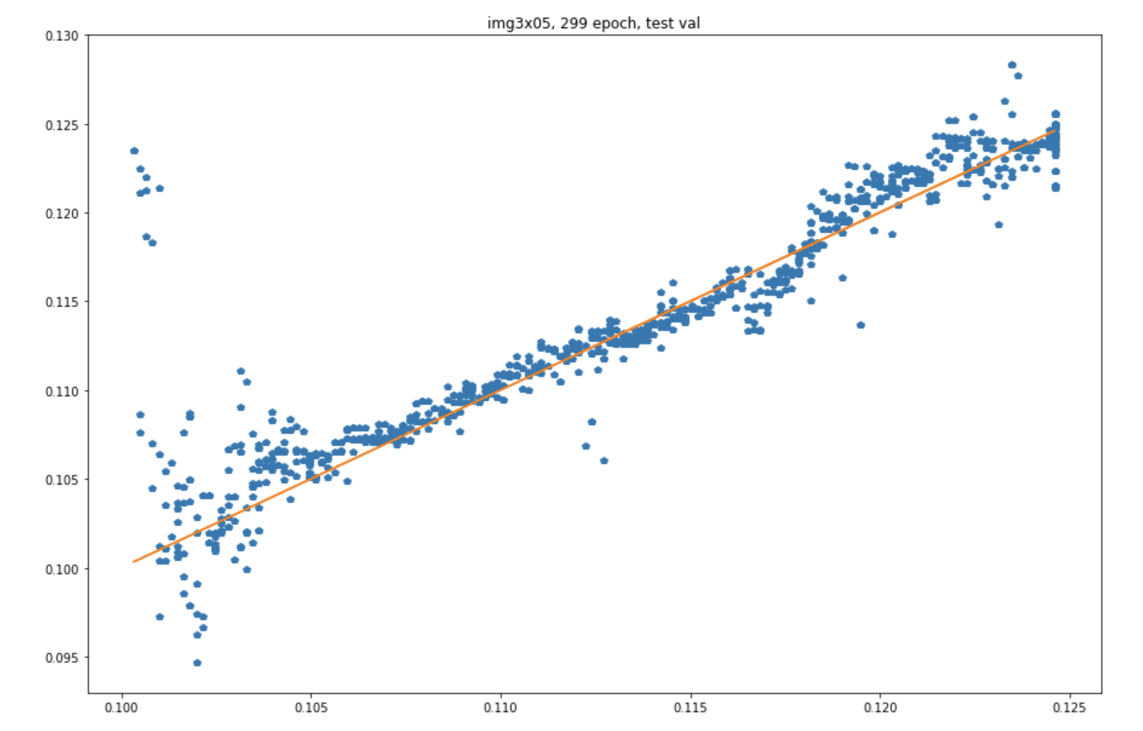
Convolutional Neural Network (CNN)

Slide 12
Principle Component Analysis + neural network

Slide 13
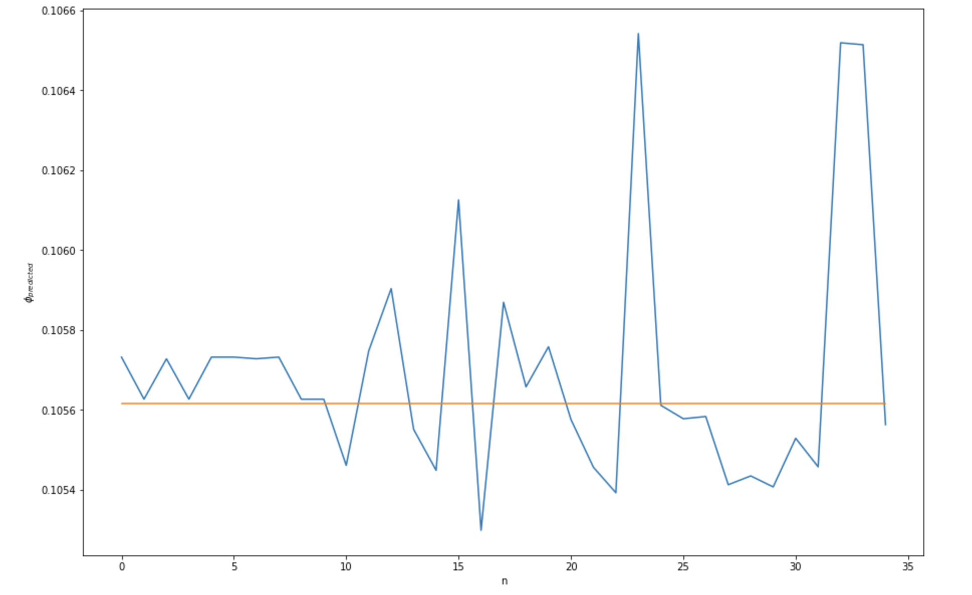
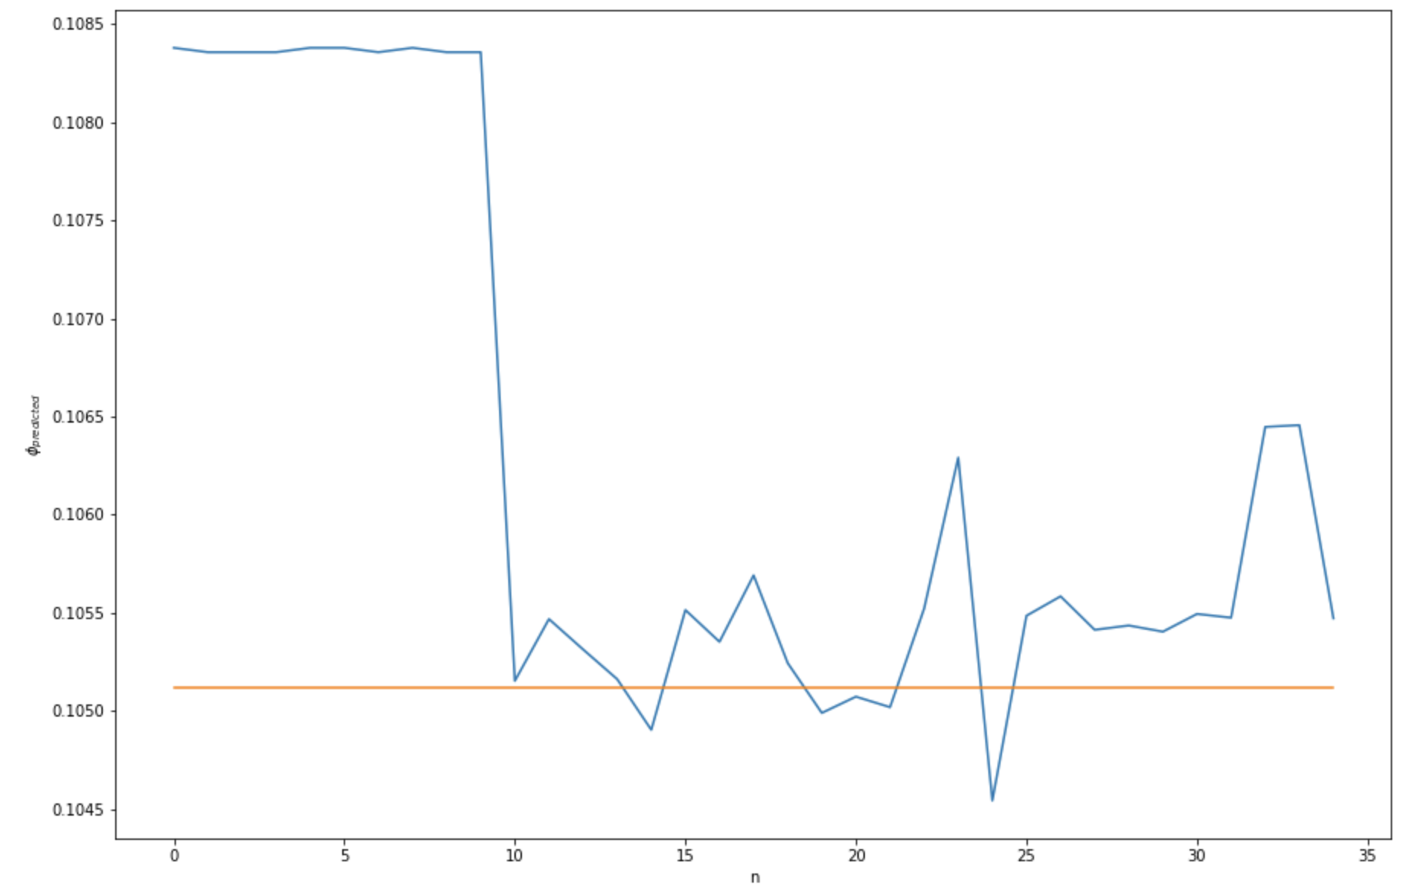
Ensemble methods
Several models make predictions using random part of train data. Using these predictions one prediction is made using the following methods
Mean
Quantile
Clusterization
These methods allows us achieve best results because of
Every models improve each other
Delete bed predictions
Find familiar predictions

Slide 14
Ensemble efficiency

Slide 15
Future steps
Improve optical scheme
Automatizing
Stаbilizing
Fast measurements and better data
More powerful and precise models
Better and valuable data
1
Other models
Boosting nets
2
Preprocessing
3

